Slide 1

How to implement beautiful placeholders during image loading?

Slide 2

What is placeholder?

Slide 3
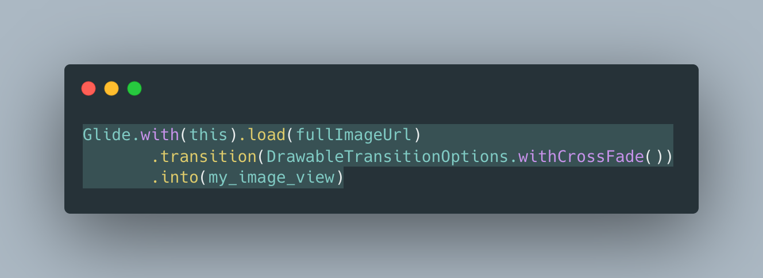
Leave without placeholder 😏

Slide 4
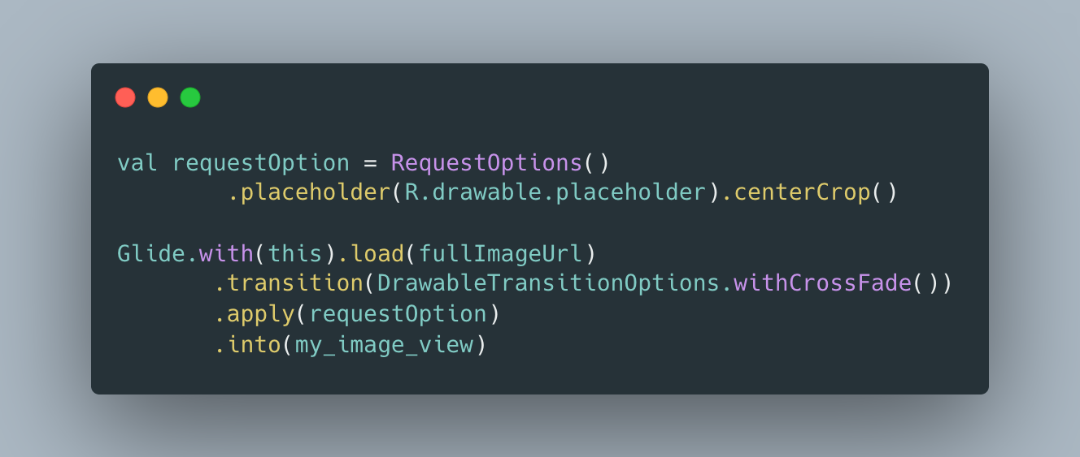
Use predefined color

Slide 5
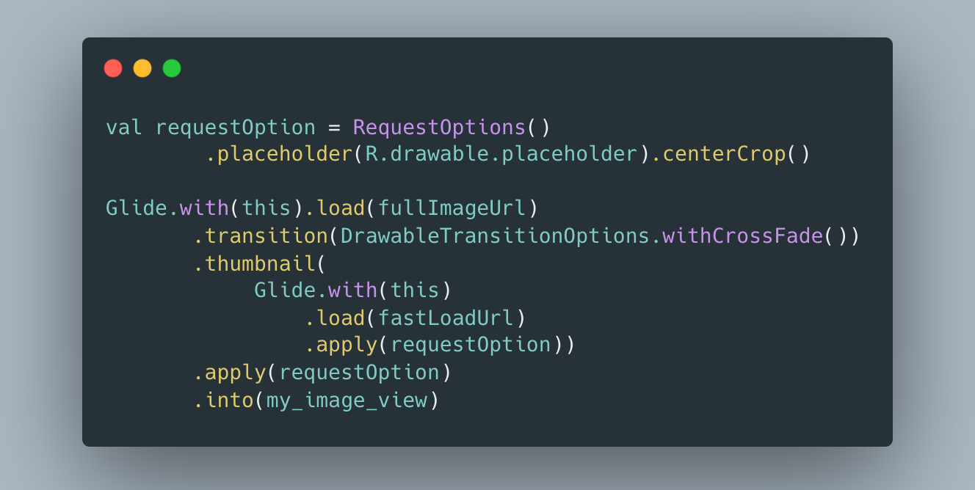
Use thumbnails
Notes:
Not efficient for storage size, need to store additional images on backend

Slide 6
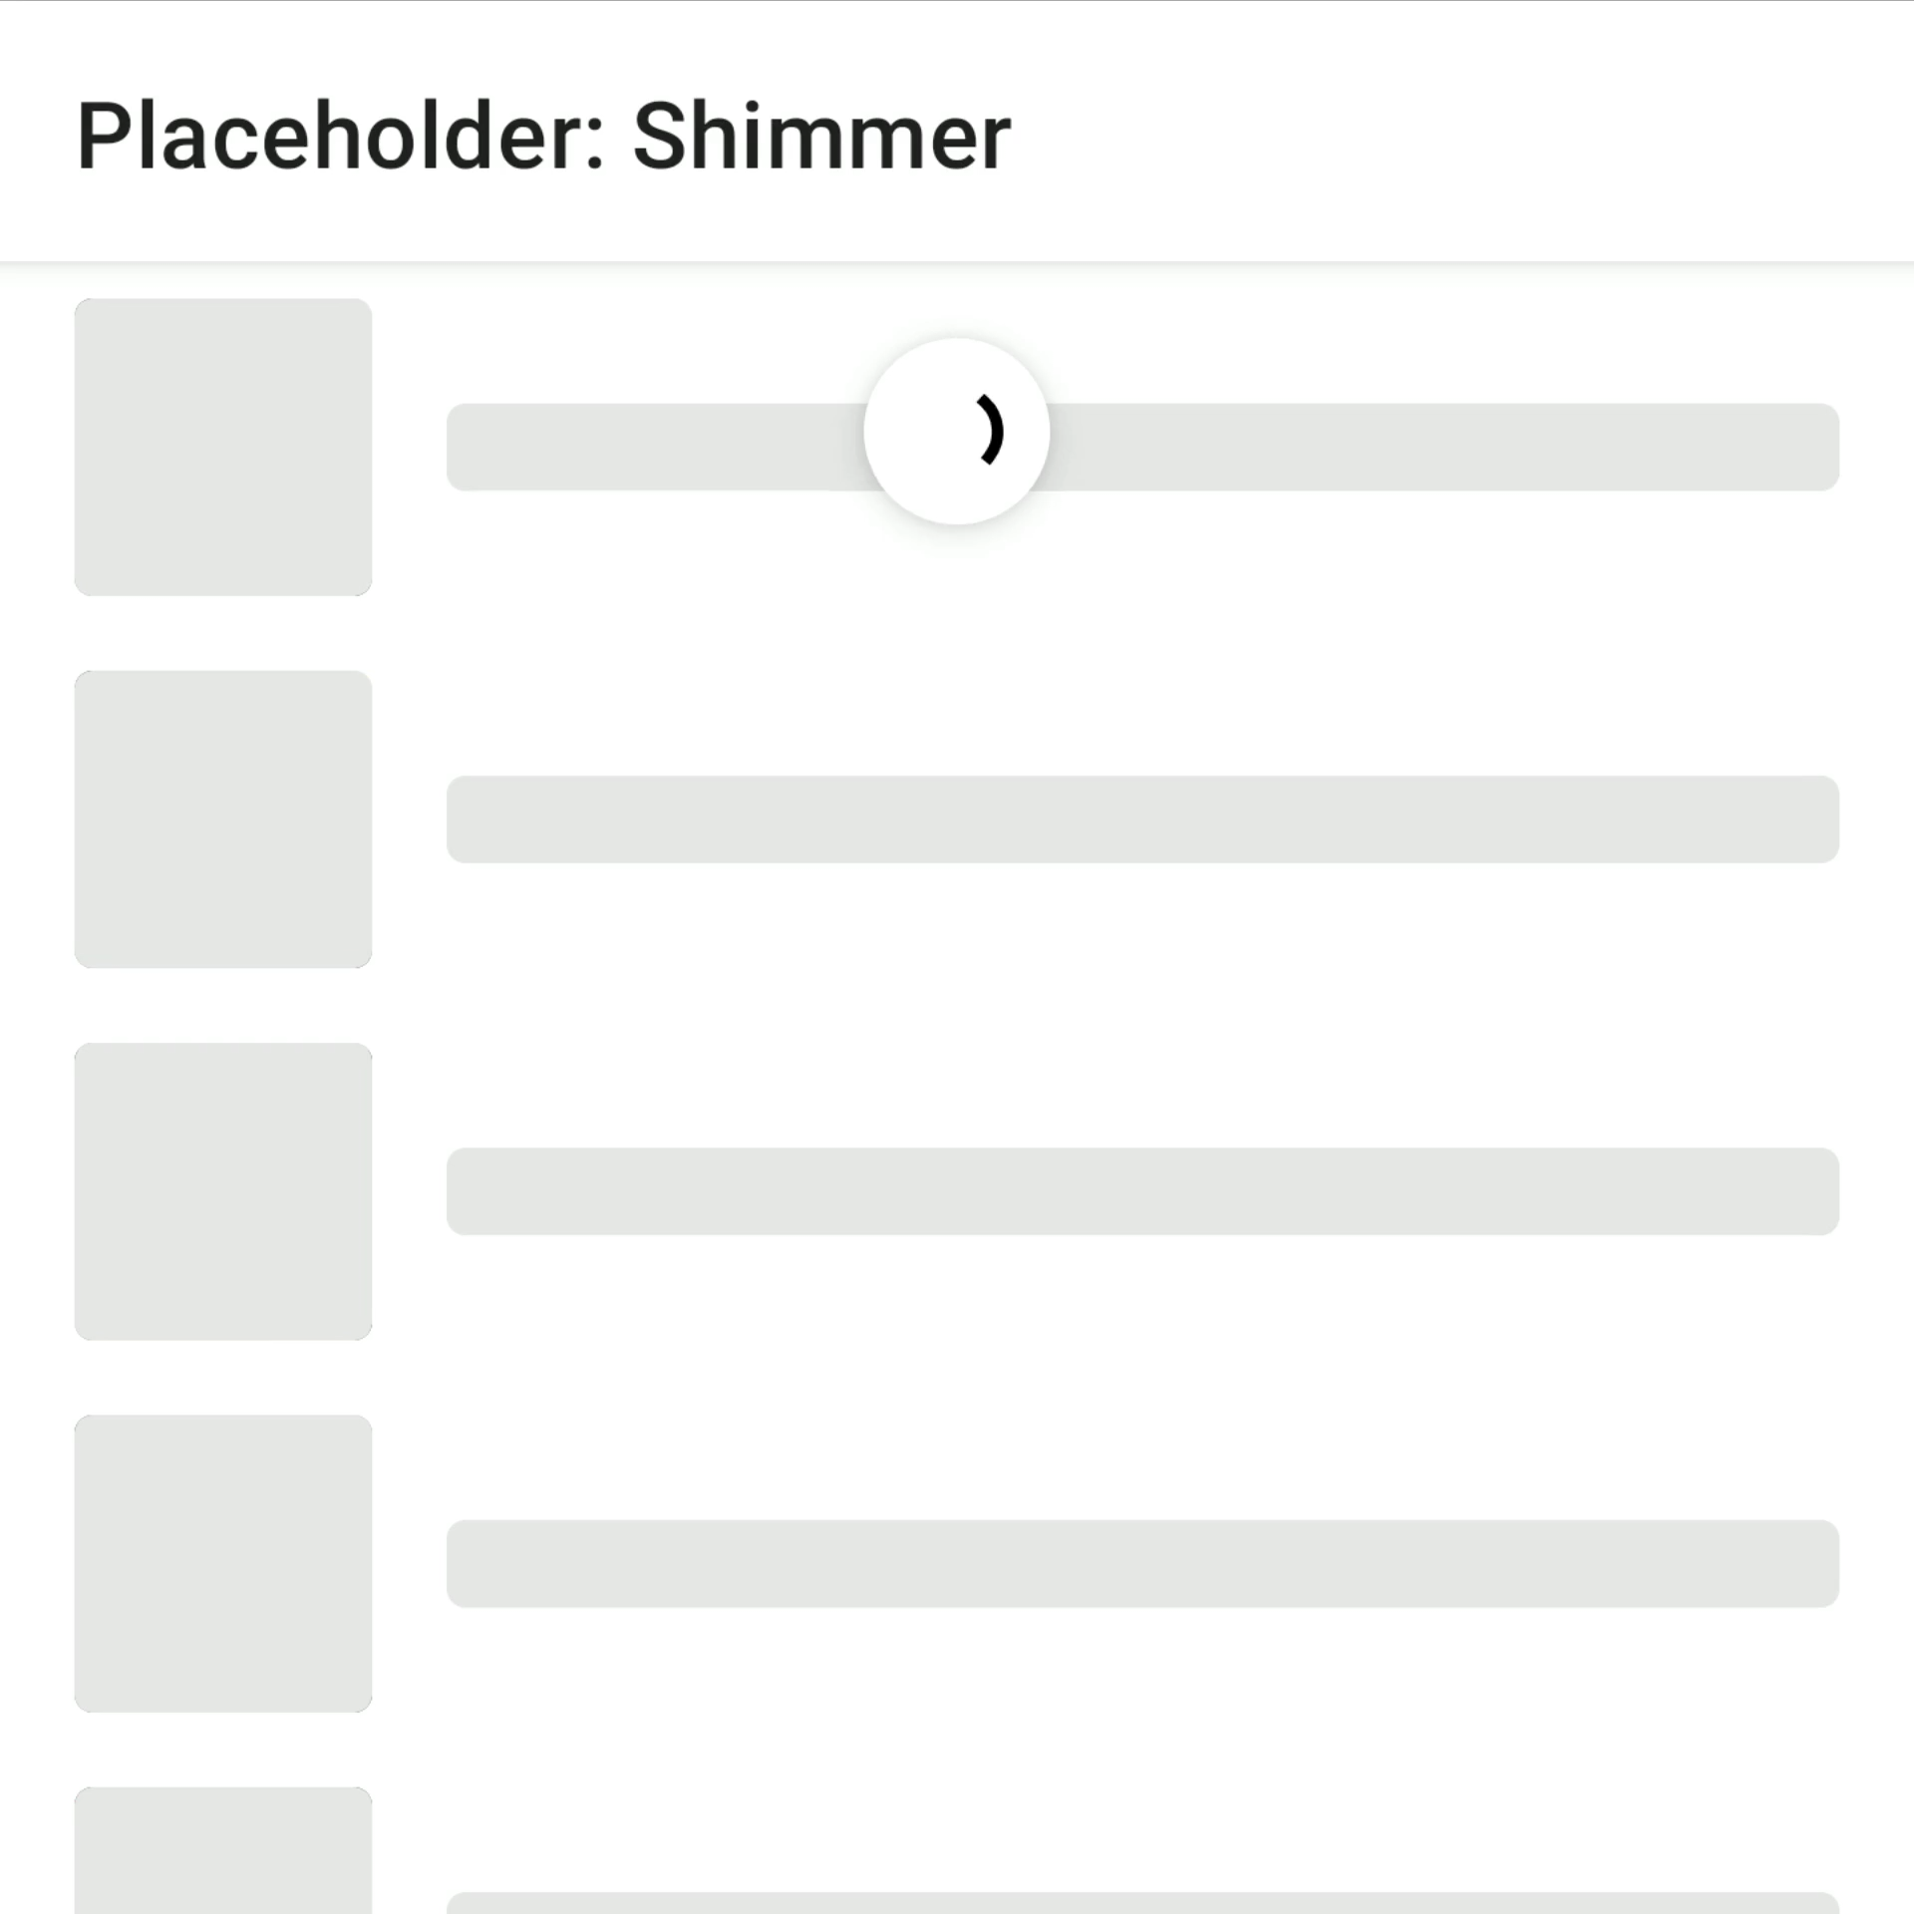
Other
Blur thumbnail image during loading
Shimmer effect

Slide 7
Ideal approach
Simple solution for clients
Avoid additional image resources on backend
Scalable for different platforms

Slide 8

BlurHash

Slide 9
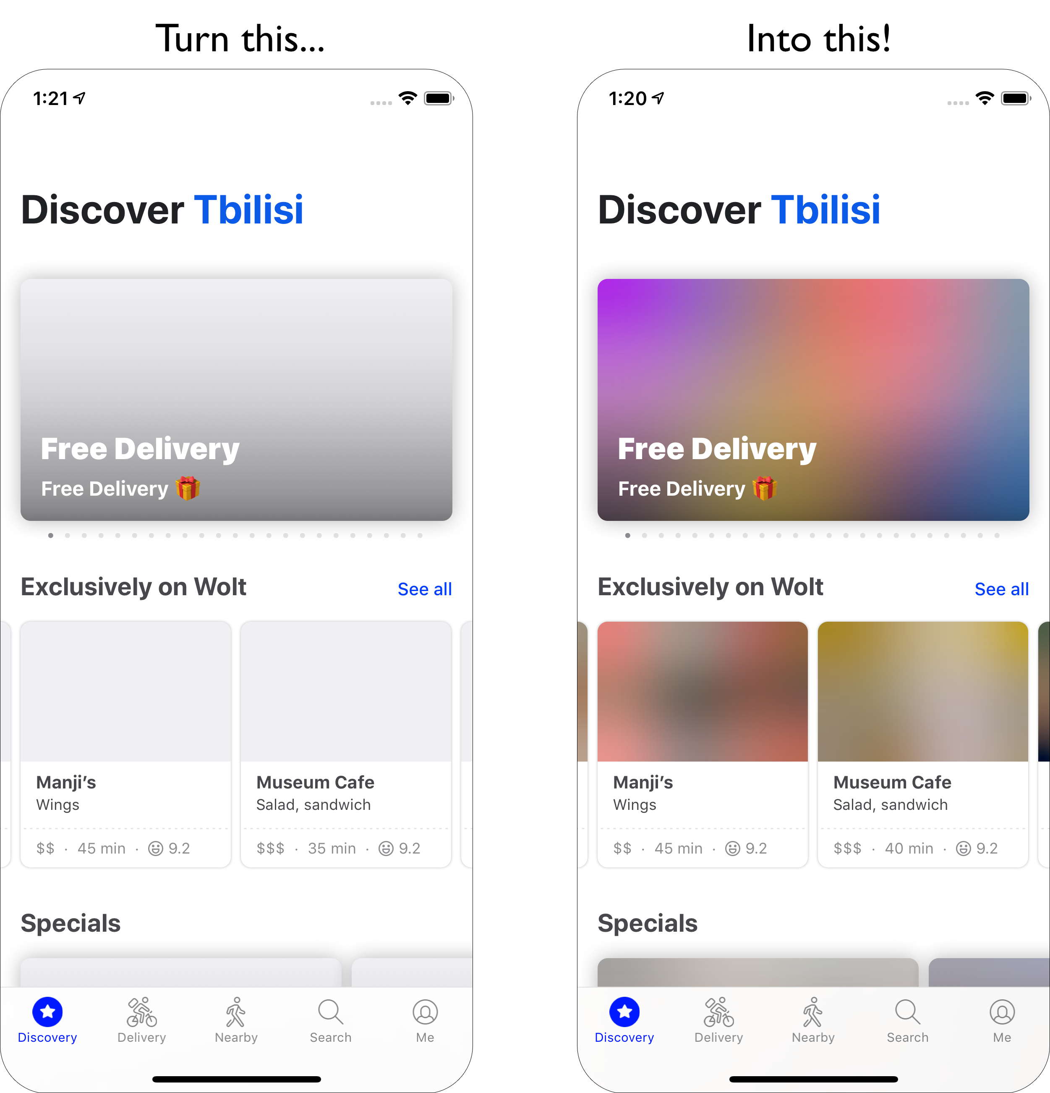

Slide 10
How it works (simple)
BlurHash takes an image and convert it into short string (only 20-30 characters!) using Base83
Developers can do this on the backend and store the string along with the image.
Backend send JSON with image URL and BlurHash string.
Client decodes it into an image that it shows while the real image is loading over the network.

Slide 11
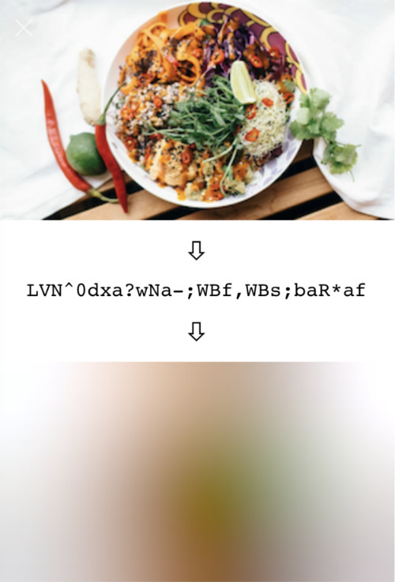
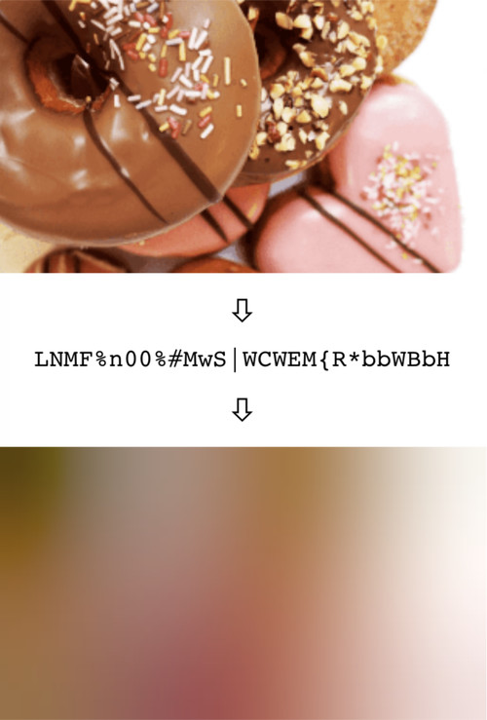

Slide 12
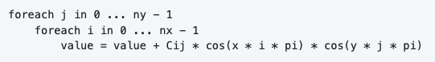
How it works under the hood
Algorithm uses Discrete Cosine Transform (DCT) transformation technique for data compression (mostly uses on JPEG, MPEG, MP3 formats)
To decode a single pixel of output, need to loop over the DCT components and calculate a weighted sum of cosine functions.
Keeping only the few components and encodes using base 83 encoding: 0123456789ABCDEFGHIJKLMNOPQRSTUVWXYZabcdefghijklmnopqrstuvwxyz#$%*+,-.:;=?@[]^_{|}~
Notes:
Дискретное косинусное преобразование

Slide 13

Supported languages
C, Swift, Kotlin, TypeScript, Python, Go, PHP, Java, Clojure, Nim, Rust, WebAssembly, Ruby, Elm, Dart, .NET

Slide 14


Who uses on production?
Wolt: Delivery service
Signal Messenger
Unsplash

Slide 15
Other usecases
Masking images without having to use expensive blurs
Quick extraction color averages of the image from different areas (without palette library)

Slide 16
Useful links
https://github.com/woltapp/blurhash
https://blurha.sh/
Sample app (BlurHash): https://github.com/egorikftp/TechTalk

